Slide 1
CARING FROM WITHIN: TEAM 1
Aaron Han, Derek Chung, Michelle Xu, Tristan Wang

Slide 2
1.
INTRODUCTION

Slide 3
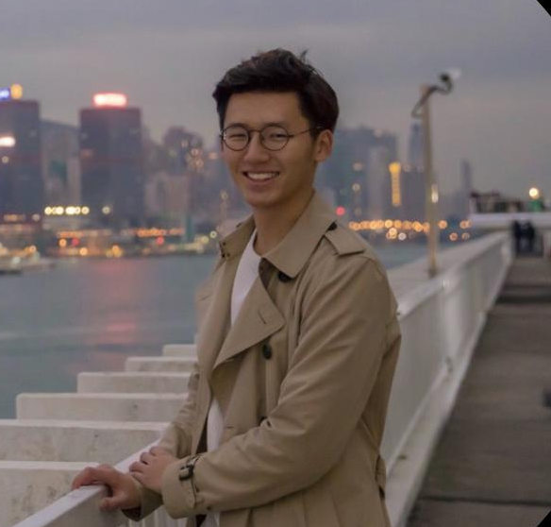
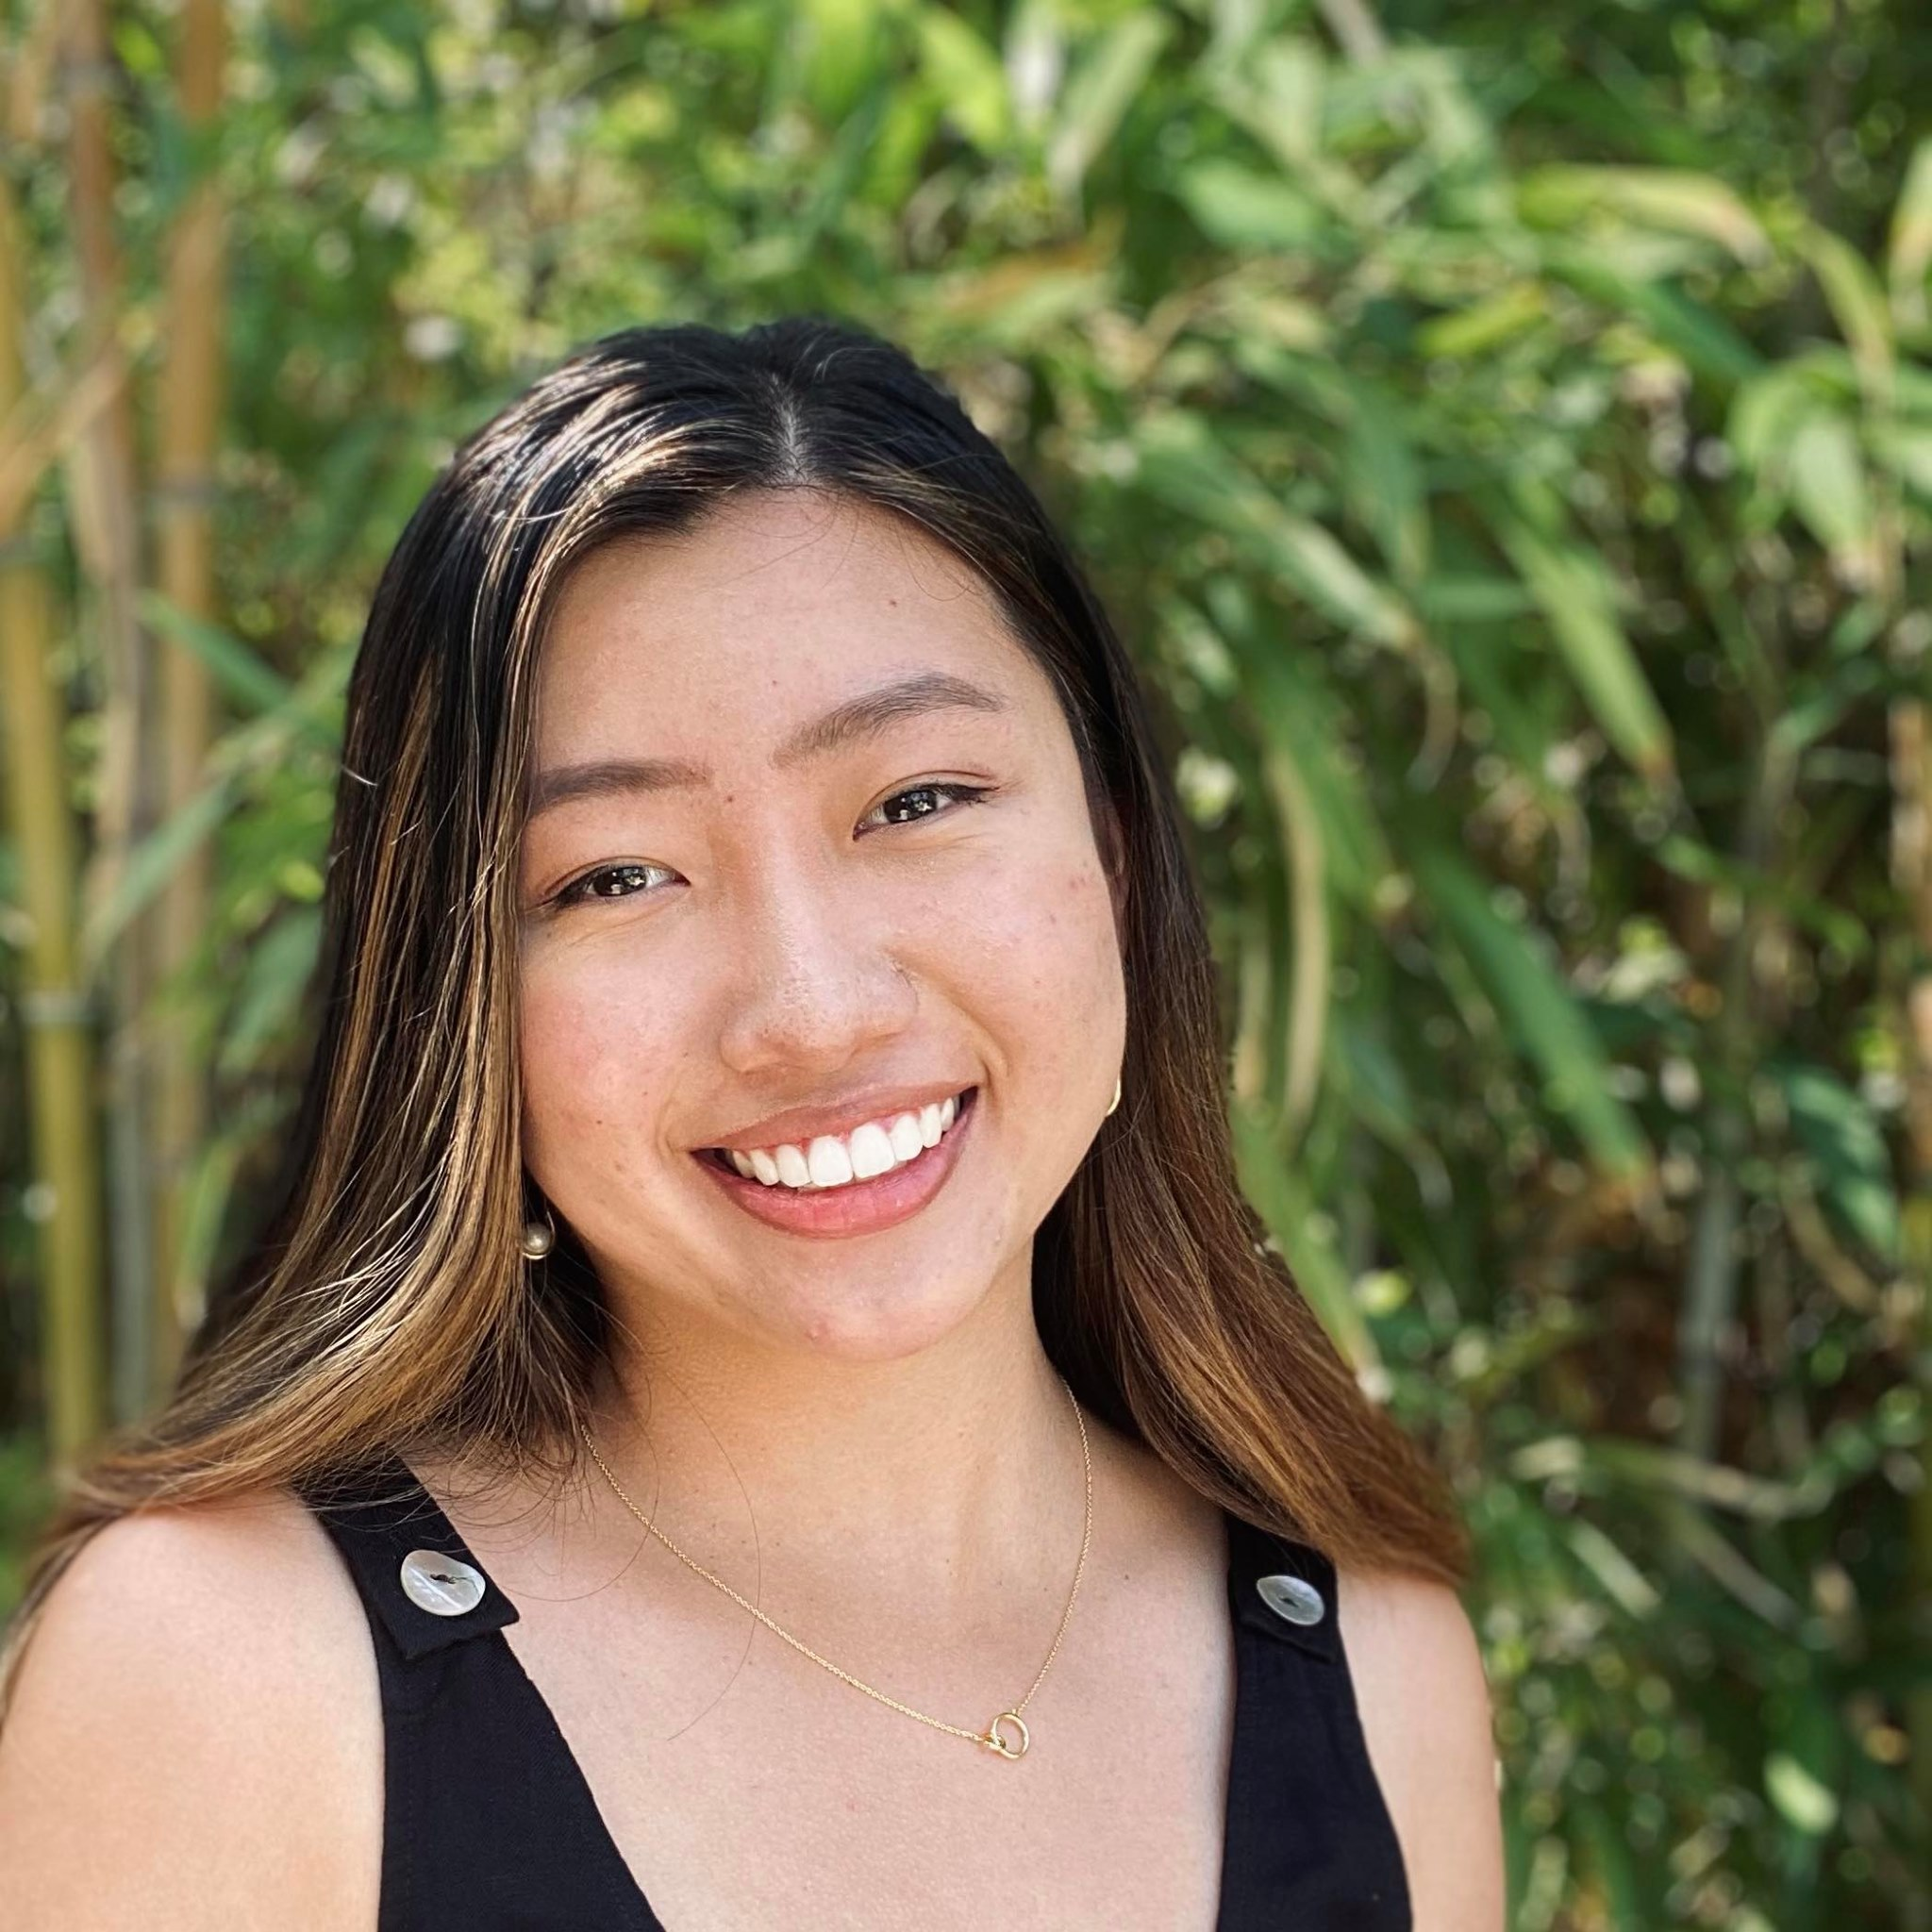
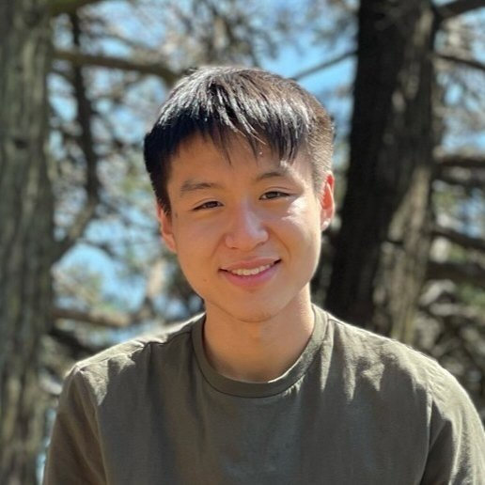
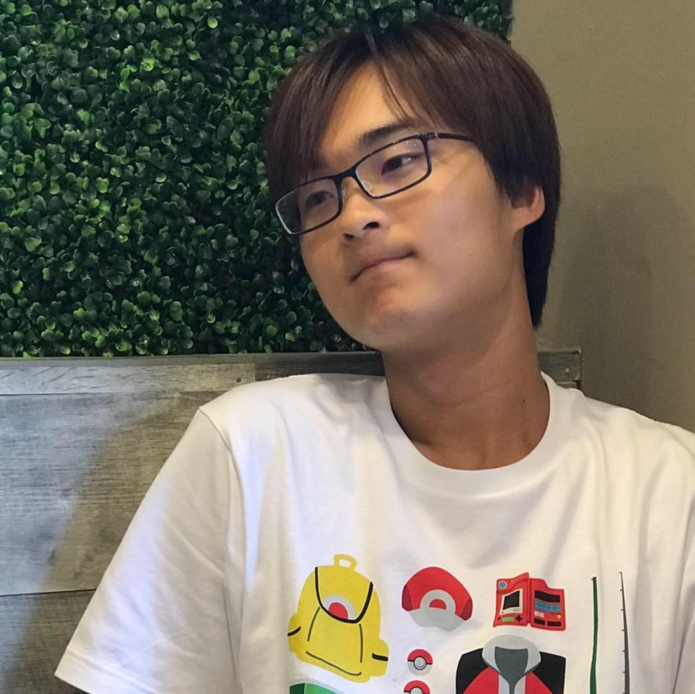
MEET THE TEAM
Aaron Han
B.S. MCS, c/o 2022
M.S. CS, c/o 2023
Michelle Xu
B.A. Econ, c/o 2022
M.S. CS, c/o 2023
Derek Chung
B.S. CS + Music, c/o 2022
M.S. CS, c/o 2023
Tristan Wang
B.S. CS, c/o 2023

Slide 4
Problem Domain
Changes brought by the COVID pandemic has amplified many mental health issues among our communities. Therefore, we will be focused especially on tackling the issues affecting one’s well-being as a result of the pandemic.

Slide 5
2.
NEEDFINDING METHODOLOGY

Slide 6
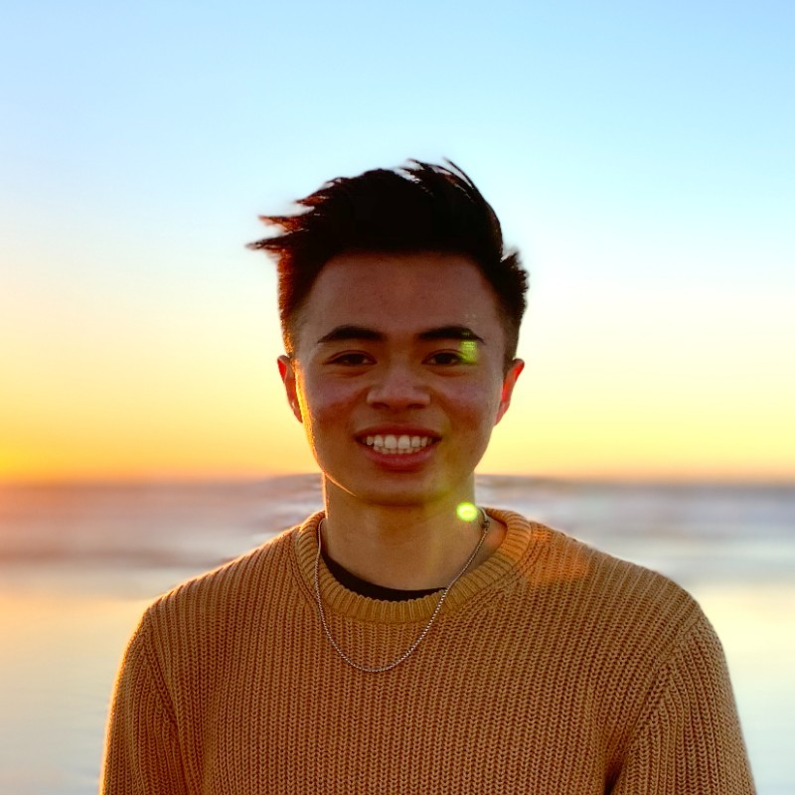
PARTICIPANTS
Angelo, former Stanford alum

Slide 7
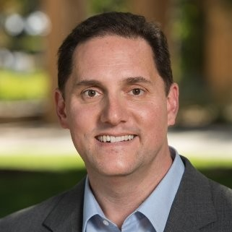
PARTICIPANTS
Angelo, former Stanford alum
Chris, Economics professor

Slide 8
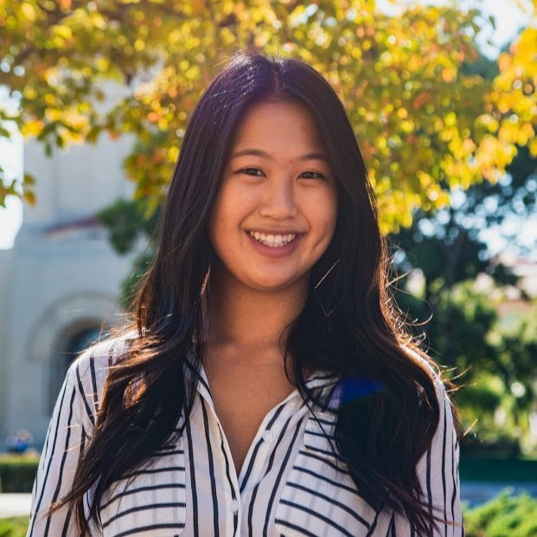
PARTICIPANTS
Angelo, former Stanford alum
Chris, Economics professor
Jessie, former Stanford alum

Slide 9
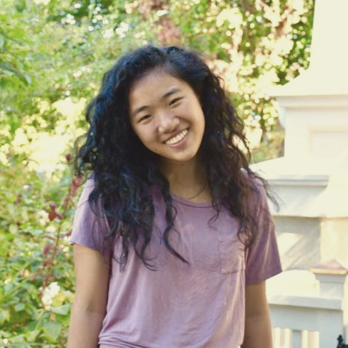
PARTICIPANTS
Angelo, former Stanford alum
Chris, Economics professor
Jessie, former Stanford alum
Maryanne, Northeastern student

Slide 10
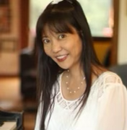
PARTICIPANTS
Angelo, former Stanford alum
Chris, Economics professor
Jessie, former Stanford alum
Maryanne, Northeastern student
Sueanne, piano teacher

Slide 11
EXTREME USER
Jessie
Stanford c/o 2020
Former Stanford PHE
Experience with resources such as CAPS and BetterHelp

Slide 12
The Interview

Slide 13
The Interview
Work
“How was the transition to remote work?”

Slide 14
The Interview
Work
Social Life
“How was the transition to remote work?”
“How did the lockdown affect your personal relationships?”

Slide 15
3.
INTERVIEW RESULTS

Slide 16
CONSISTENT RESULTS
Increased time at home also increased tension

Slide 17
CONSISTENT RESULTS
Increased time at home also increased tension
People don’t get as much out of remote work

Slide 18
CONSISTENT RESULTS
Increased time at home also increased tension
People don’t get as much out of remote work
There was a pressure to be productive with all the time

Slide 19
CONSISTENT RESULTS
Increased time at home also increased tension
People don’t get as much out of remote work
There was a pressure to be productive with all the time
People missed in-person interactions

Slide 20
CONSISTENT RESULTS
Increased time at home also increased tension
People don’t get as much out of remote work
There was a pressure to be productive with all the time
People missed in-person interactions
Fear of losing social connections

Slide 21

“I don’t want to be a social outcast.”
“We had all sort of held it together until our dog passed away.”
“I did a lot of work on my charity because I would have felt bored doing nothing at home.”
“My relationship with my family worsened because of all the time at home.”
“I felt like I didn’t get the time I wanted or deserved.”

Slide 22
SURPRISES
One participant was not excited for in-person interactions
One participant wanted the entire school year off because of the ineffectiveness of online teaching
One participant was sadder that his internship went remote rather than Stanford going remote

Slide 23
4.
ANALYSIS

Slide 24
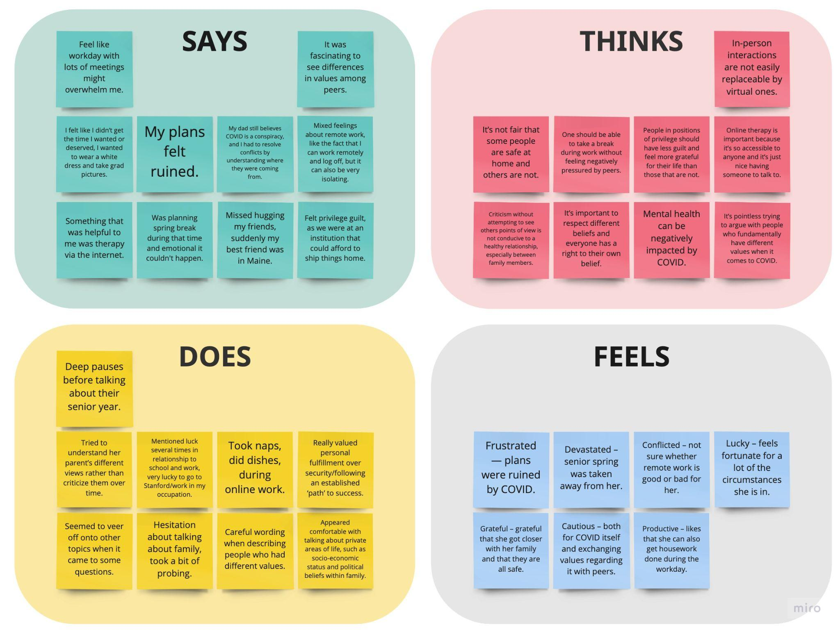

Slide 25
Tensions
Friends had different values and didn’t care about bringing COVID back to their families.

Slide 26
Tensions
Friends had different values and didn’t care about bringing COVID back to their families.
Contradictions
Upset about COVID and lack of in-person interactions but likes remote work.

Slide 27
Tensions
Friends had different values and didn’t care about bringing COVID back to their families.
Contradictions
Upset about COVID and lack of in-person interactions but likes remote work.
Surprises
Biggest emotional factor for her was privilege guilt.

Slide 28
QUESTIONS
How can we ease tension among people who are stuck in the same space?

Slide 29
QUESTIONS
How can we ease tension among people who are stuck in the same space?
How can we increase motivation for remote work?

Slide 30
QUESTIONS
How can people use their privilege to help others?
How can we ease tension among people who are stuck in the same space?
How can we increase motivation for remote work?

Slide 31
QUESTIONS
How can people use their privilege to help others?
How can we ease tension among people who are stuck in the same space?
How can we increase motivation for remote work?
How can we manage relationships that include a mismatch of values?

Slide 32
SUMMARY
INSIGHTS
NEEDS
People get into arguments when they’re in the same space for too long.
A way to have their own “space” when they physically don’t have enough space.

Slide 33
SUMMARY
INSIGHTS
NEEDS
People get into arguments when they’re in the same space for too long.
A way to have their own “space” when they physically don’t have enough space.
People are not motivated with remote work.
A way to make them feel engaged with coworkers while being apart.

Slide 34
SUMMARY
INSIGHTS
NEEDS
People get into arguments when they’re in the same space for too long.
A way to have their own “space” when they physically don’t have enough space.
People are not motivated with remote work.
A way to make them feel engaged with coworkers while being apart.
People feel guilty with all their privilege.
A way to make productive use of their privilege.

Slide 35
SUMMARY
INSIGHTS
NEEDS
People get into arguments when they’re in the same space for too long.
A way to have their own “space” when they physically don’t have enough space.
People are not motivated with remote work.
A way to make them feel engaged with coworkers while being apart.
People feel guilty with all their privilege.
A way to make productive use of their privilege.
People have differences in values when it comes to COVID.
A way to maintain relationships that suffer from a difference in values.

Slide 36
THANK YOU!

